Slide 1
Module 4
Whitebox Testing

Slide 2
Index
Whitebox testing
Control flow testing
Data flow testing

Slide 3
Whitebox testing
White Box Testing is software testing technique in which internal structure, design and coding of software are tested to verify flow of input-output and to improve design, usability and security
In white box testing, code is visible to testers so it is also called Clear box testing, Open box testing, Transparent box testing, Code-based testing and Glass box testing

Slide 4
What do you verify in WhiteBox Testing?
White box testing involves the testing of the software code for the following:
Internal security holes
Broken or poorly structured paths in the coding processes
The flow of specific inputs through the code
Expected output
The functionality of conditional loops
Testing of each statement, object, and function on an individual basis

Slide 5

How do you perform White Box Testing?
Step 1) Understand the source code
Step 2) Create test cases and Execute

Slide 6
Types of WhiteBox Testing
Unit Testing: It is often the first type of testing done on an application. Unit Testing is performed on each unit or block of code as it is developed. Unit Testing is essentially done by the programmer.
Testing for Memory Leaks: Memory leaks are leading causes of slower running applications. A QA specialist who is experienced at detecting memory leaks is essential in cases where you have a slow running software application.

Slide 7
White Box Penetration Testing: In this testing, the tester/developer has full information of the application's source code, detailed network information, IP addresses involved and all server information the application runs on. The aim is to attack the code from several angles to expose security threats.
White Box Mutation Testing: The idea behind mutation testing is to make a few arbitrary changes to a program at a time. Each time the program is changed, it is called a mutated program and the change effected is called a mutant.
Mutation-based testing approach is that it is computationally very expensive, since a large number of possible mutants can be generated.
Several test tools are available that automatically generate mutants for a given program

Slide 8
Advantages of WhiteBox Testing
Code optimization by finding hidden errors
White box tests cases can be easily automated
Testing is more thorough as all code paths are usually covered
Disadvantages of WhiteBox Testing
White box testing can be quite complex and expensive
White box testing requires professional resources, with a detailed understanding of programming and implementation.
White-box testing is time-consuming, bigger programming applications take the time to test fully

Slide 9
WhiteBox Testing Techniques
Control flow testing
Data flow testing

Slide 10
Control flow testing
Control flow testing is a testing technique that comes under white box testing
The aim of this technique is to determine the execution order of statements or instructions of the program through a control structure
The control structure of a program is used to develop a test case for the program
In this technique, a particular part of a large program is selected by the tester to set the testing path

Slide 11
Notations used for Control Flow Graph
It is mostly used in unit testing
Test cases represented by the control graph of the program.
Control Flow Graph is formed from the node, edge, decision node, junction node to specify all possible execution path
Node : Used to create a path of procedures. Basically, it represents the sequence of procedures
Edge : Used to link the direction of nodes
Decision Node : Used to decide next node of procedure as per the value
Junction node : Point where at least three links meet

Slide 12
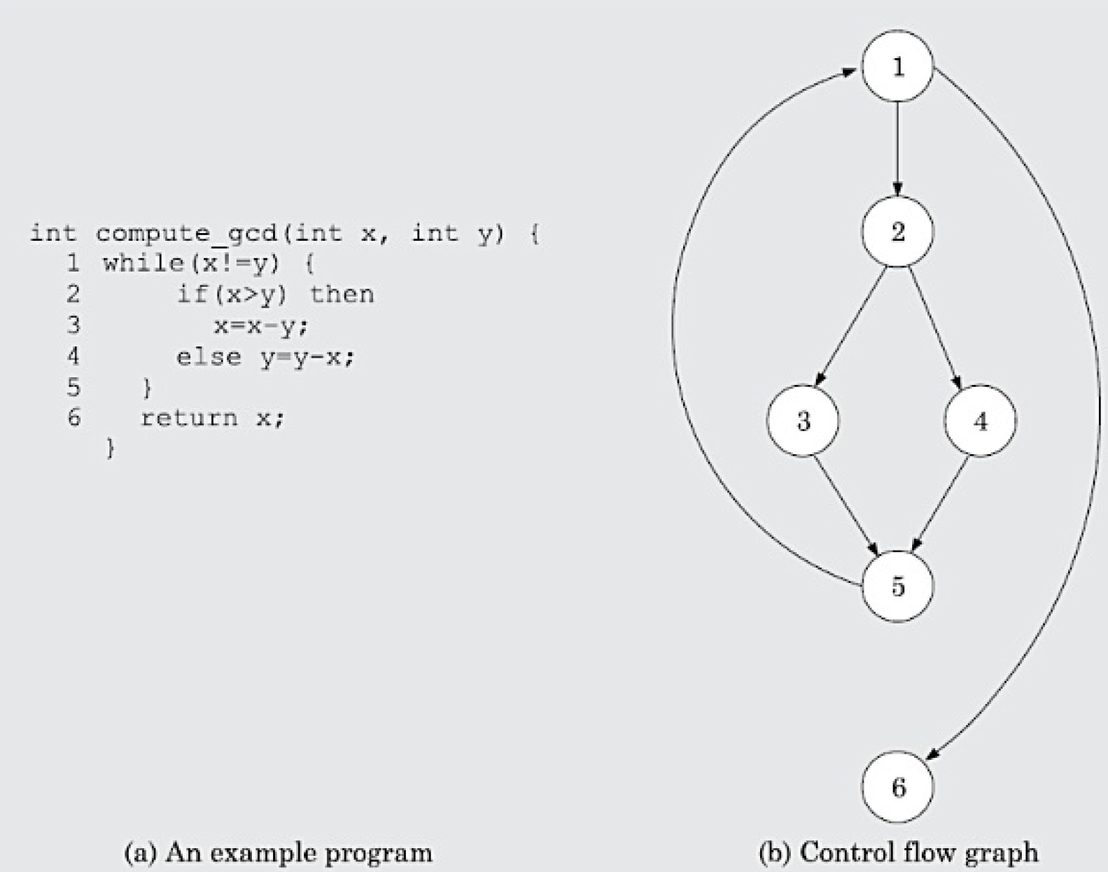
Example

Slide 13
path coverage testing does not try to cover all paths, but only a subset of paths called linearly independent paths(basis paths ).
if each path in the set introduces at least one new edge that is not included in any other path in the set.
McCabe’s Cyclomatic Complexity Metric
McCabe’s cyclomatic complexity defines an upper bound on the number of independent paths in a program.
Given a control flow graph G of a program, the cyclomatic complexity V(G) can be computed as: V(G) = E – N + 2
where, N is the number of nodes of the control flow graph and E is the number of edges in the control flow graph.

Slide 14
Data flow testing
Data Flow Testing is a specific strategy of software testing that focuses on data variables and their values
It makes use of the control flow graph
It can be considered as a type of white box testing and structural types of testing
It keeps a check at the data receiving points by the variables and its usage points
The process is conducted to detect the bugs because of the incorrect usage of data variables or data values

Slide 15
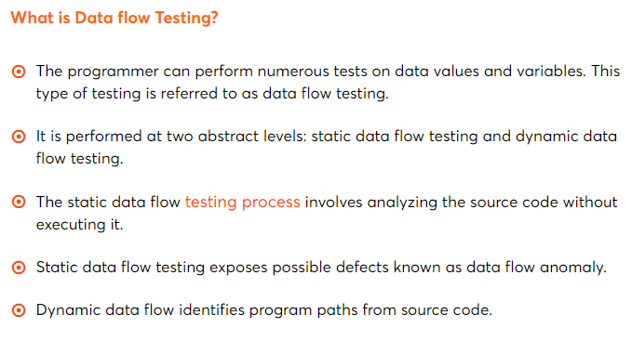

Slide 16
Data flow testing
Furthermore, it is concerned with:
Statements where variables receive values,
Statements where these values are used or referenced.
To illustrate the approach of data flow testing, assume that each statement in the program is assigned a unique statement number. For a statement number S-
DEF(S) = {X | statement S contains the definition of X}
USE(S) = {X | statement S contains the use of X}

Slide 17
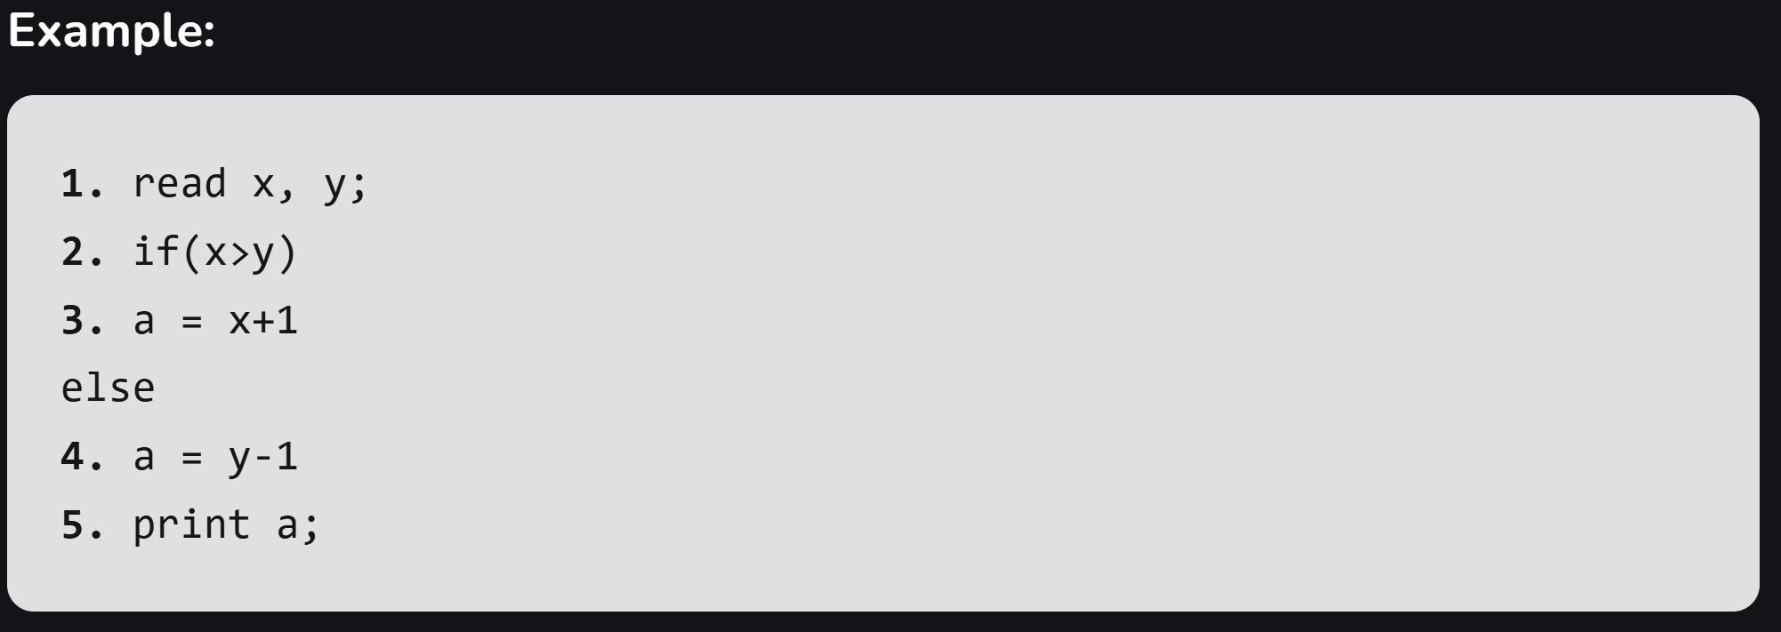
Data flow testing

Slide 18
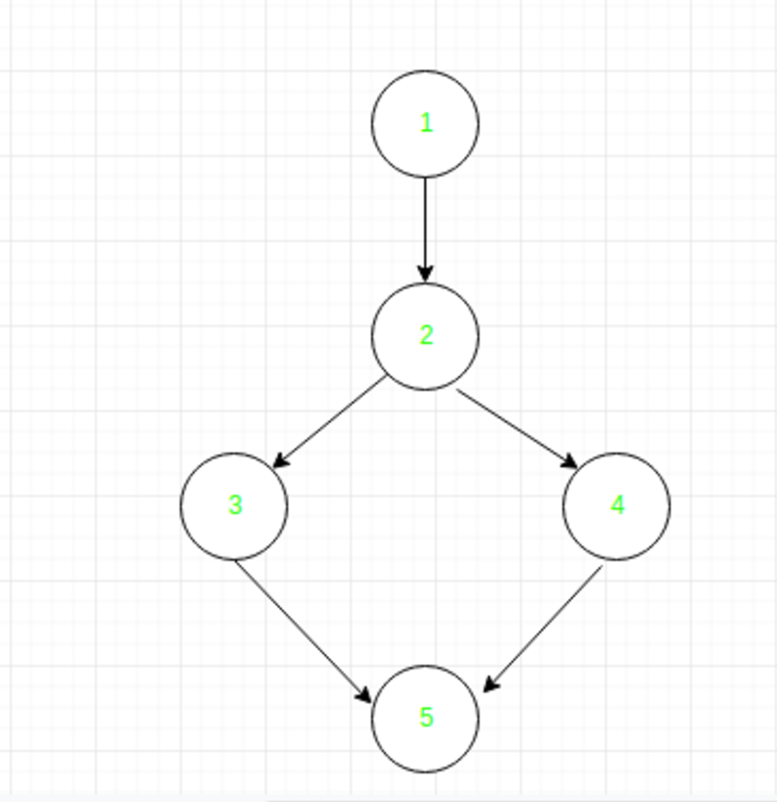
Data flow testing
Variable | Defined at node | Used at node
x | 1 | 2, 3
y | 1 | 2, 4
a | 3, 4 | 5

Slide 19
Advantages of Data Flow Testing:
Data Flow Testing is used to find the following issues-
To find a variable that is used but never defined,
To find a variable that is defined but never used,
To find a variable that is defined multiple times before it is use,
Deallocating a variable before it is used.
Disadvantages of Data Flow Testing
Time-consuming and costly process
Requires knowledge of programming languages

Slide 20
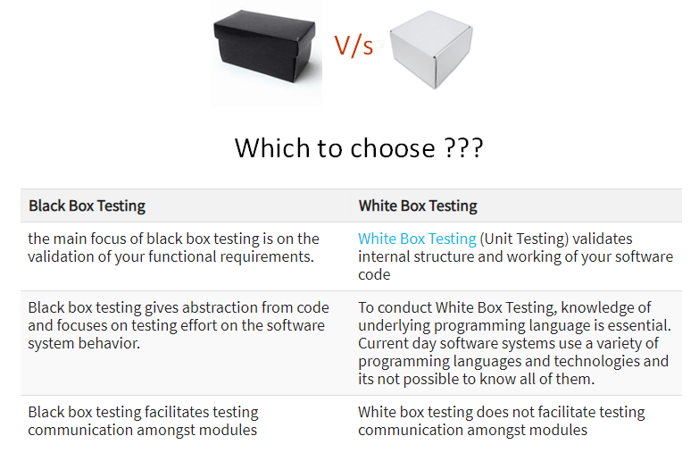
Comparison of Black Box and White Box Testing:

